Slide 1
Shared Memory Machines
Presentaion about How Shared Memory machines work.

Slide 2
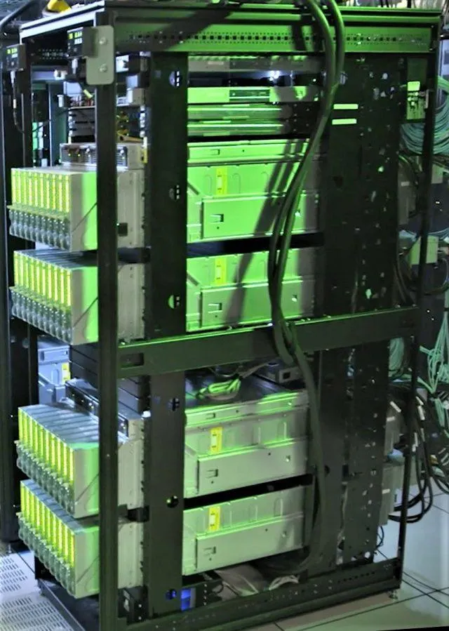
What is Shared Memory Machine Means?
Shared Memory Machines are like
a team of friends working together on a
giant puzzle.
In this setup, each friend (processor)
can directly look at and add pieces to a big table (shared memory).
Unlike puzzles where each friend has their own pieces (distributed memory),
here they all share the same set.

Slide 3
How can we Imagine SMM?
Working Together
Communication
Imagine friends sitting around a big table working (Shared memory) on different sections of the puzzle (each process).
They can easily see what others are doing and share pieces since they all use the same table.
Communication is as simple as talking or pointing to parts of the puzzle on the shared table.
Process is done with another one and shared memory like access point for each process by reading and writing

Slide 4
Types of Shared Memory Architectures?
uniform memory access (UMA)
Non-uniform memory access (NUMA)
access times to different parts of the shared memory may vary. It's like some parts of the memory are closer to specific processors, and accessing data in those areas is faster for the nearby processors.
Everyone in the library has equal access to all the books and
resources.
No matter where you sit, the time it takes to get a book is the same for everyone
each processor has equal access time to any part of the shared memory
The café has different sections, and the time it takes to get a coffee may vary depending on where you're seated.
Those sitting near the coffee counter get their coffee faster than those at a distance.

Slide 5

Scientific Definition
uniform memory access (UMA)
Non-uniform memory access (NUMA)
In shared memory multiprocessor systems, all processors access a single memory through an interconnection network, ensuring equal access time and speed
it is also known as SMP (Symmetric multiprocessor) systems.
In this model, each processor connects to dedicated memory, creating a unified address space with variable memory access times based on processor distance.
Access to any memory location is achieved using physical addresses.

Slide 6
